Slide 1



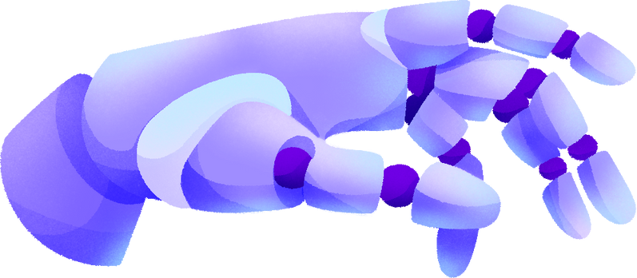

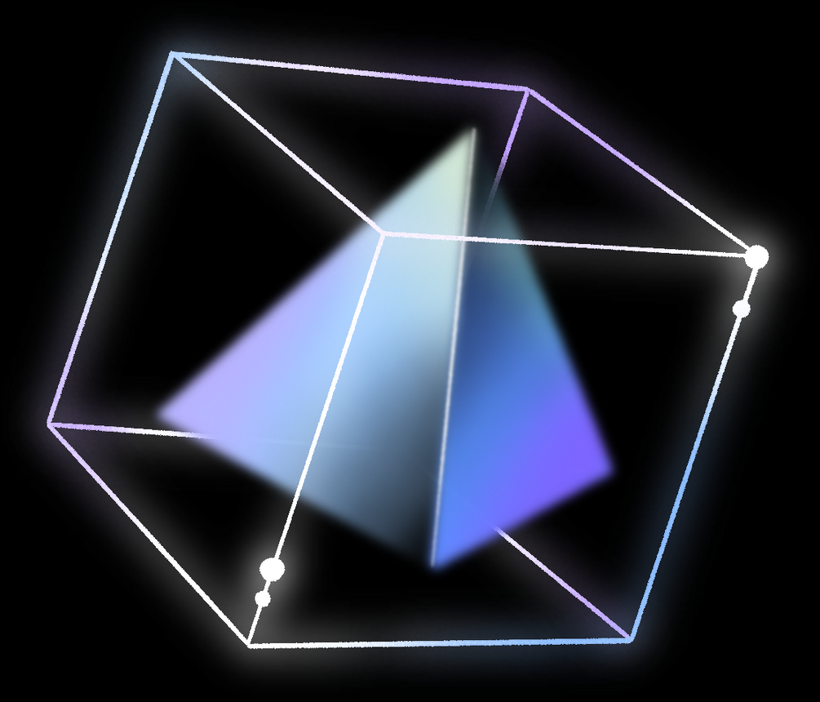
WEARABLE COMPUTER MOUSE
By
Name : N.P.K.D.Wickramasekara
Index No : 15398
Course : PH 3032 - Embedded Systems Laboratory

Slide 2
CONTENTS
Introduction
Solution
How does this work?
Functionalities
Functionalities of the ATmega32
Hardware and Microcontroller
Circuit diagram
Process
Main Pr﻿oblems

Slide 3
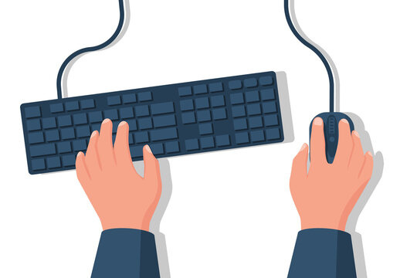
INTRODUCTION
In the world of modern computing, the need for more intuitive and portable computer input devices has become increasingly pronounced. The traditional computer mouse, while a stalwart tool for navigating digital landscapes, comes with inherent limitations that impact the user experience.
Problems
Using one hand for mouse?
Can a person who can only use their fingers operate the mouse?
Do we need a table for using this mouse?

Slide 4


SOLUTIONS
We can use the mouse by moving only one finger and perform right-click and left-click actions with a single finger. By moving two fingers, we can control the mouse. We do not need a table to use the mouse. With this wearable mouse project, we can control the mouse without moving the entire hand.
Wearable Mouse

Slide 5


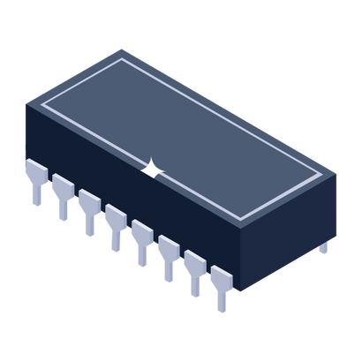

HOW DOES THIS WORK?
GET DATA
SEND DATA
Ring
Microcontroller
Computer

Slide 6

HOW DOES THIS WORK?
MEASUREMENTS
X
Y

Slide 7
HOW DOES THIS WORK?
WORKING WITH A COMPUTER SCREEN
Y
X
Y
X

Slide 8
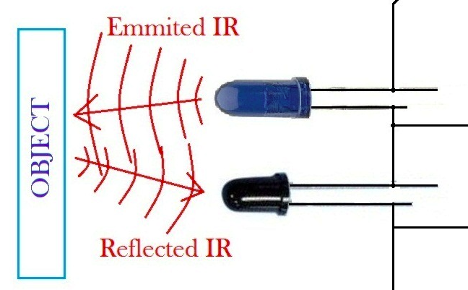
HOW DOES THIS WORK?
WHAT CAN WE USE TO TAKE MEASUREMENTS?
X
Y

Slide 9

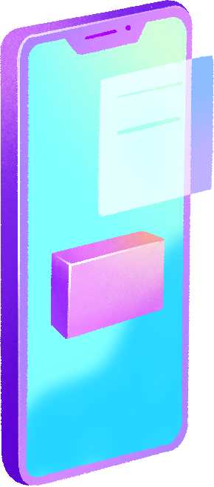

FUNCTIONALITIES
Getting x and y-axis data for cursor movement.
Functionality of the start button.
Functionality of the left-click button.
Functionality of the right-click button.

Slide 10
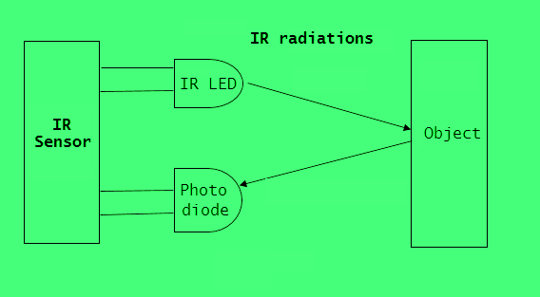
Getting x and y-axis data for cursor movement.
FUNCTIONALITIES
Ring

Slide 11
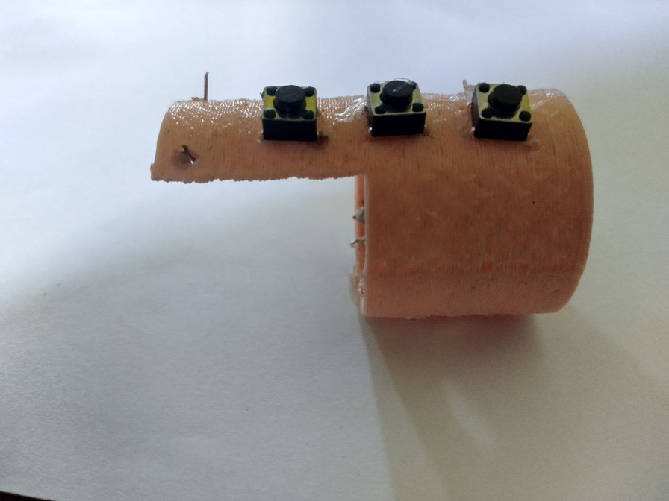
Functionality of the start button.
Functionality of the left-click button.
Functionality of the right-click button.
FUNCTIONALITIES
Left Click
Right Click
Start

Slide 12
FUNCTIONALITIES OF THE ATMEGA32
1. ADC (Analog-to-Digital Converter):
ADC allows the microcontroller to convert analog signals (e.g., sensor data) into digital values for processing.

Slide 13
FUNCTIONALITIES OF THE ATMEGA32
2. Serial Communication:
Serial communication enables data exchange between the microcontroller and external devices, such as your computer. It's crucial for transmitting and receiving data.

Slide 14
FUNCTIONALITIES OF THE ATMEGA32
3. Interrupts:
Interrupts are used for handling time-sensitive events. They allow the microcontroller to respond quickly to specific triggers, like button presses or sensor data changes.

Slide 15



HARDWARE AND MICROCONTROLLER

Slide 16






ATMEGA32 MICROCONTROLLER
We selected the ATmega32 microcontroller for our project for several reasons. It is a cost-effective option, consumes minimal energy, and is user-friendly for uploading and executing code.
PUSH BUTTON
In addition to the microcontroller, our wearable device incorporates several key components. Push buttons play a crucial role, serving as interrupt triggers for functions such as left-click, right-click, and initiating cursor movement.
UART SERIAL ADAPTOR MODULE
To facilitate communication between the computer and the microcontroller, we implemented UART (Universal Asynchronous Receiver-Transmitter). This choice not only offered seamless data transfer but also kept the design compact and budget-friendly.
IR LED AND PHOTO DIODE
To enable distance measurement, we integrated an IR (Infrared) LED and a photodiode into our design. These components were not only budget-friendly but also allowed for easy placement, given their compatibility with the design's non-circuit module structure. This setup effectively supports the device's functionality.

Slide 17
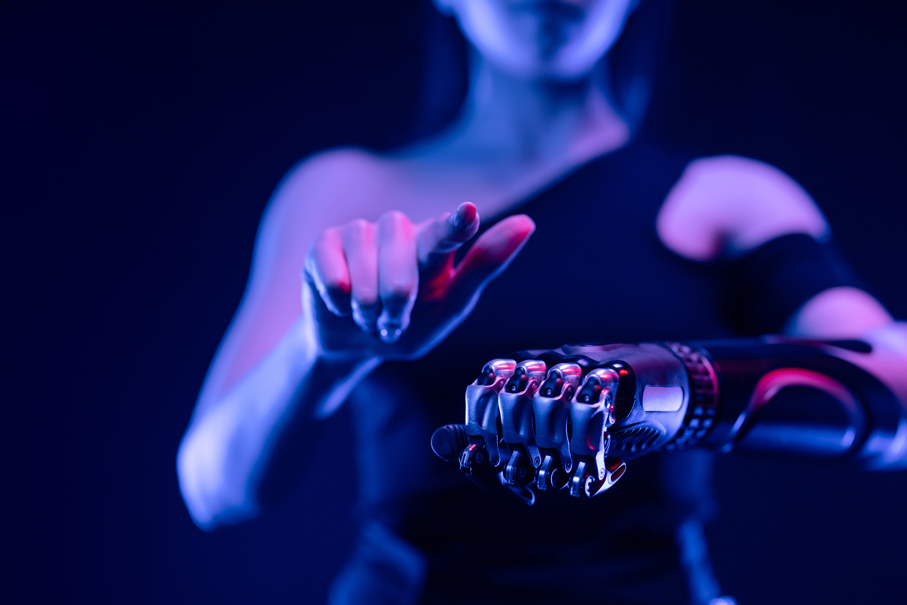
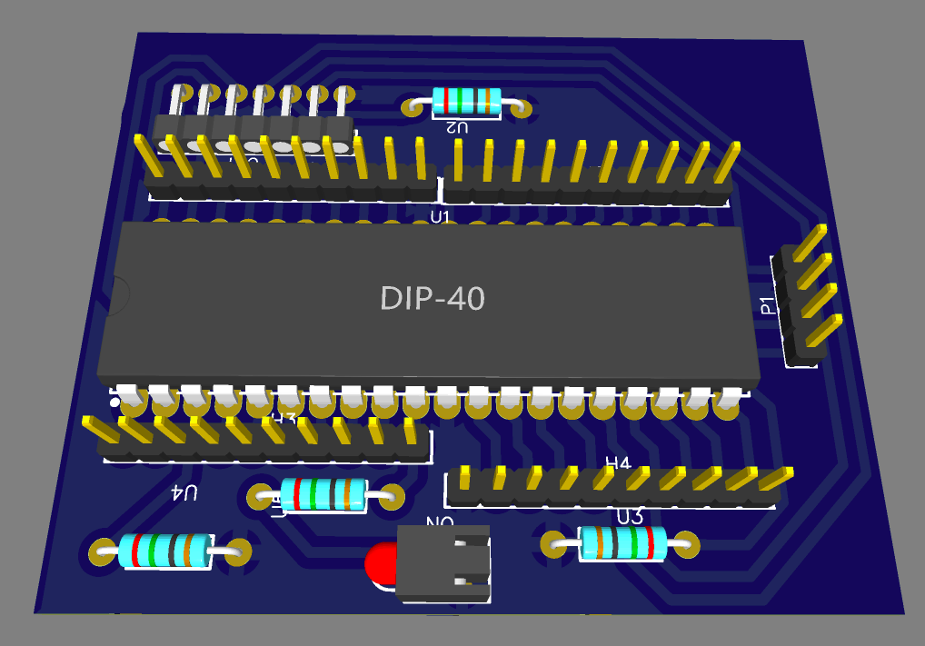

CIRCUIT DIAGRAM

Slide 18
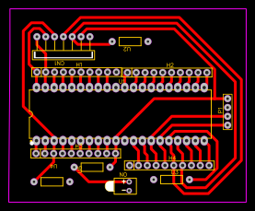
CIRCUIT DIAGRAM

Slide 19




PROCESS
01
The ATmega32 microcontroller is responsible for reading data from the photodiode. It utilizes the Analog-to-Digital Converter (ADC) to convert incoming analog voltage values into digital data that can be processed.

Slide 20
PROCESS
The captured data is then processed within the microcontroller. Once processed, the information is ready for transmission to a computer.
To achieve this communication, the ATmega32's TX (Transmit) pin is connected to the UART's RX (Receive) pin, enabling data to flow from the microcontroller to the computer.
Additionally, the ATmega32's RX (Receive) pin is connected to the UART's TX (Transmit) pin, ensuring a two-way data exchange.
02

Slide 21
PROCESS
In Python, we can seamlessly interface with our wearable device to capture serial data and translate it into real-time cursor movement.
To achieve this, we employ three essential modules:
Serial Module
PyAutoGUI Module
Time Module
03

Slide 22
PROCESS
By harnessing the power of these Python modules, we bridge the gap between the data collected by the wearable device and the seamless cursor control on your computer screen. The result is a fluid and user-friendly experience that transforms finger movements into intuitive cursor navigation.
03

Slide 23
MAIN PROBLEMS
1. FINDING THE PERFECT SENSOR
2. DEALING WITH LONG WIRE CONNECTIONS
3.INTEGRATING COMPONENTS INTO THE RING

Slide 24

THANK YOU!

